Slide 1

Township POS
Simple Sales Credit Tracking

Slide 2

Introduction
Informal shops are vital to township economies, but most still rely on notebooks or memory to track sales and stock.
This makes it hard to manage cash flow and nearly impossible to access credit. Our app solves this by providing a simple, offline-first POS system that records sales, manages stock, and builds a financial history.
With these records, shop owners can not only run their businesses more efficiently, but also unlock access to loans and formal financial services that fuel real growth.

Slide 3
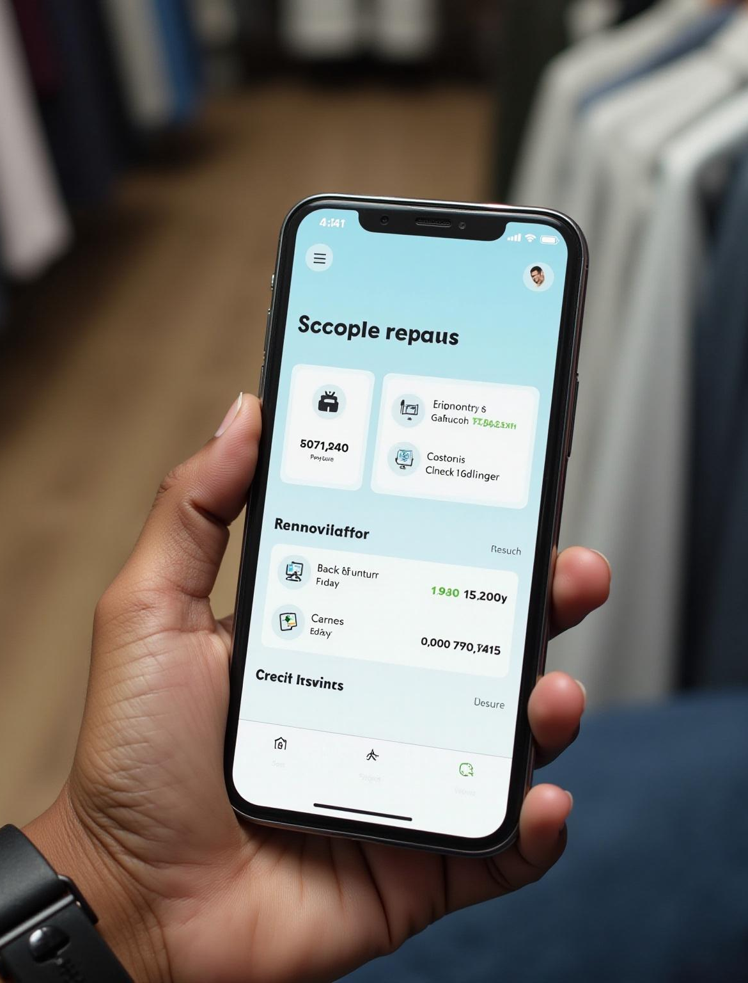
Product Overview
Product Name: Township POS
What it is:
A simple, offline-first Point of Sale app built for informal shops and spaza businesses.
The Problem:
Shop owners struggle with manual record-keeping, poor visibility into profits, and no access to credit.
The Solution:
Township POS makes it easy to record sales, manage stock, and track expenses in real time — all from a mobile phone, even without internet.
Key Features (MVP):
Record sales in a few taps
Manage products and stock
Track daily/weekly sales and profits
Offline-first with local database
Future Features:
Digital receipts (print or WhatsApp)
Customer credit tracking
Exportable reports for banks & suppliers
Credit scoring to unlock loans and growth
Value Proposition:
Affordable and simple to use
Works in low-connectivity environments
Builds financial history → enables access to credit and formal banking
Bridges the gap from informal trading to sustainable business growth

Slide 4
Problem Faced by Informal Shops
Informal shops struggle with manual record-keeping, lack of profit visibility, and limited access to loans or credit facilities.

Slide 5
Offline-first POS Solution
A simple offline-first POS app records sales, manages expenses, tracks stock, and builds financial history for credit scoring support.

Slide 6
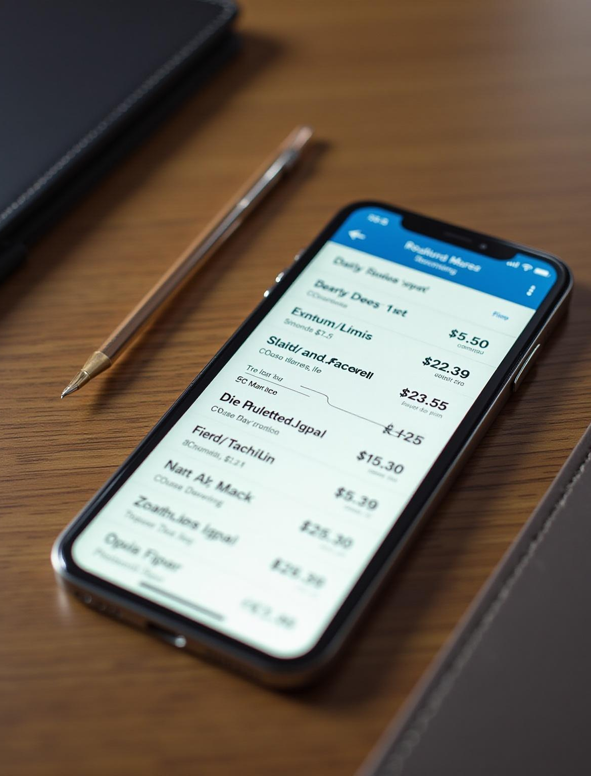
Core Features / MVP
Record sales in a few taps
Manage products and stock
Track daily/weekly sales and profits
Offline-first with local database

Slide 7

Business Impact & Development
Better Financial Control → Know exactly how much they sell, spend, and profit.
Reduced Losses → Fewer errors, less “disappearing money” due to manual records.
Smarter Decisions → See best-selling products and restock more strategically.
Increased Trust → Professional receipts and records improve customer confidence.
Credit Access → With a financial history, they can access microloans and supplier credit.
Job Creation → Shops that grow can employ more staff.
Financial Inclusion → Helps unbanked traders build a financial footprint.
Local Economy Boost → Stronger small shops keep money circulating locally.

Slide 8

Benefits and User Persona
This app helps informal shops better manage finances and build credit history. Ideal for users like Miriam, a spaza shop owner seeking simple, affordable POS tools.

Slide 9
Technology Stack and Implementation
React
Node
Flask

Slide 10
Roadmap and Future Phases
Development includes Phase 1: MVP POS, Phase 2: receipts and credit tracking, and Phase 3: cloud sync with financial services integration.

Slide 11
Conclusions
Township POS empowers informal businesses with digital tools to improve financial management, access credit, and support growth through simple, offline-first technology.

Slide 12
Thank you
Do you have any questions?
thuto42096@gmail.com
sihlek56@gmail.com
Please keep this slide for attribution

